Slide 1


Capstone 2023

Slide 2

Frederick Soontang Network Administrator
Leonardo Finkelstein
System Administrator
Tilak Patel
Network Technician
Swapon Dhar
Network Technician
Roberto Herrera
Network Technician

Slide 3

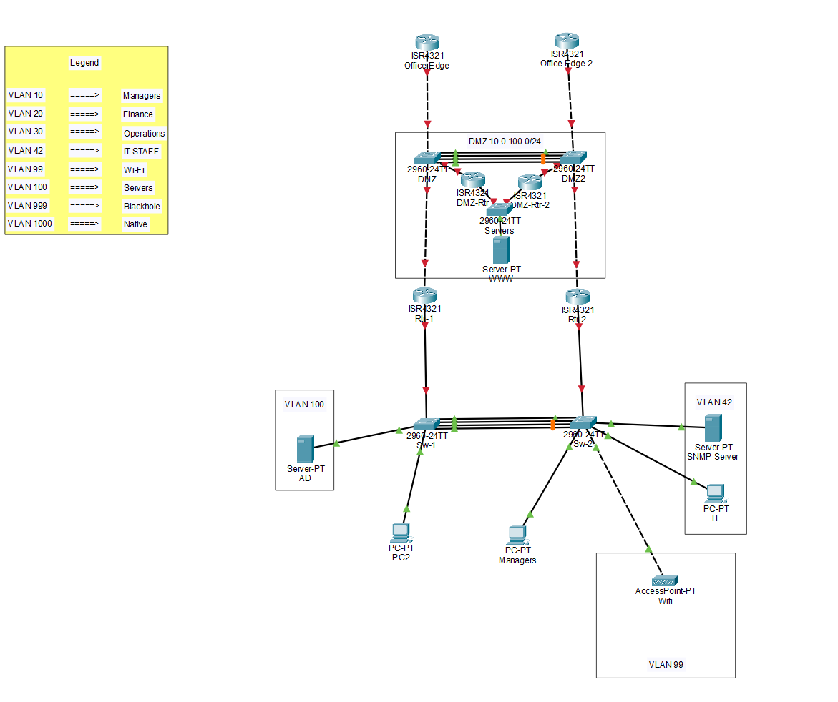
The Solution
Documentation and Addressing.
Protocols enabled
OSPF V2
SSH V2
GLBP
Email
Active Directory
GPO’s
DNS - DHCP
Monitoring
SNMP

Slide 4
The Solution
Redundancy
Etherchannel
GLBP
Dynamic Routing
Backup server
Security
Best Practices
Port security
ACL’s - DMZ
Servers
Web server
AD

Slide 5


Active Directory
Configuration
GPO's
Permissions
DNS
DHCP
Hardware
Windows server 2016
10 gb Memory
4 cores CPU
60 gb Disk
VM Deployment

Slide 6
Web Server
Mail Service
Ubuntu OS
VM Deployment
Capacity
www.capstoneit.online
Office 365

Slide 7


THANKS
THANKS

